Slide 1
Effective Utilization of Coir Raw Material to Avoid wastage
PIP2001 University Project
Review-4
Batch Number: CIT-G05
Roll Number | Student Name
20211CIT0077 | Poojitha U
20211CIT0149 | Rakesh.R
20211CIT0058 | D.Vachan Kumar
Under the Supervision of,
Ms Soumya –Assistant Professor-SCSE
Presidency University

Slide 2
Abstract
The effective utilization of coir raw materials is a critical step towards minimizing wastage and enhancing the sustainability of the coconut industry.
Coir, derived from coconut husks, holds immense potential in various sectors, including agriculture, construction, and textiles.
However, improper handling, inefficient processing techniques, and a lack of streamlined supply chain management often result in significant raw material wastage.
By leveraging digital platforms for real-time updates on availability, demand, and distribution, the industry can ensure efficient resource allocation.

Slide 3
Introduction
In the coconut industry, access to real-time information about raw material availability is a major challenge.
To bridge this gap, our solution is a web platform designed for seamless interaction between farmers, industries, and data analytical firms.
By allowing farmers to update raw material data through both a web login and SMS system, and enabling industries to track availability and complete transactions transparently, our platform ensures efficiency and accountability.
.

Slide 4
Research Gaps
Inadequate Real-Time Data on Coir Availability:
Limited systems to provide real-time updates on coir raw material stocks across regions, leading to mismatches in supply and demand.
Lack of Standardized Quality Assessment:
Absence of widely accepted standards for assessing the quality of coir raw materials, leading to wastage during processing.
Inefficient Collection and Transportation Systems:
Insufficient logistics frameworks for collecting and transporting coir husks and fibers from production points to processing units.

Slide 5
Research Gaps
Underutilization of Byproducts:
Inadequate research on the potential applications of coir byproducts such as coir pith, leading to wastage and environmental challenges.
Poor Integration of Technology in Coir Processing:
Minimal use of advanced technologies like IoT, AI, and blockchain for tracking, processing, and optimizing coir material usage.
Policy and Regulatory Gaps:
Lack of supportive policies or incentives for coir waste minimization and recycling initiatives.

Slide 6
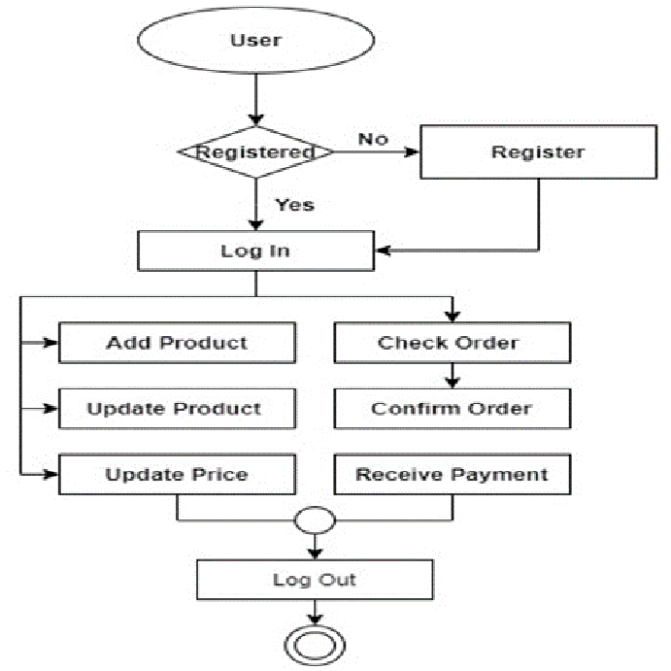
Proposed Methodology
1. User Registration:
Unregistered User: If a user is not registered, they are prompted to register with valid ID proof.
Registered User: If a user is already registered, they can proceed to log in.
2. User Login:
Logged-in User: After successful login, the user is presented with a menu of options.
3. Farmer Actions:
Add Product: Farmers can add new products (raw materials) to the database.
Update Product: Farmers can update existing product information, such as quantity or availability.
Update Price: Farmers can update the prices of their products.
User Flow Diagram for Coir Raw Material Web Platform

Slide 7
Proposed Methodology
4. Industry Personnel Actions:
Check Order: Industry personnel can check the status of their orders.
Confirm Order: Industry personnel can confirm orders once they are ready to proceed.
Receive Payment: Industry personnel can receive payment for confirmed orders.
5. Log Out:
Users can log out of the platform when they are finished.
Additional Considerations:
SMS System: Farmers can update product information via SMS in addition to the web interface.
Transaction Details: Transaction details are saved in the database for future reference and analysis.
Data Analytical Firms: Data analytical firms can access transaction data for various surveys and insights.

Slide 8
Proposed Methodology
To address the challenges of real-time raw material availability and transparency in the coconut industry, our proposed solution includes the following key points:
User Registration and Authentication
Data Input by Farmers
Real-Time Availability Updates
Transaction Management
Data Analytics Access
Transparency and Security

Slide 9
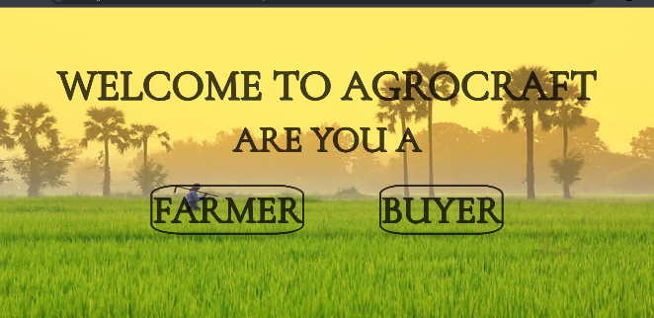
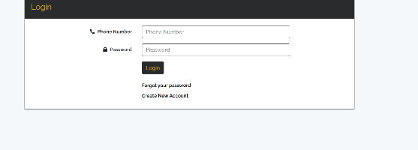
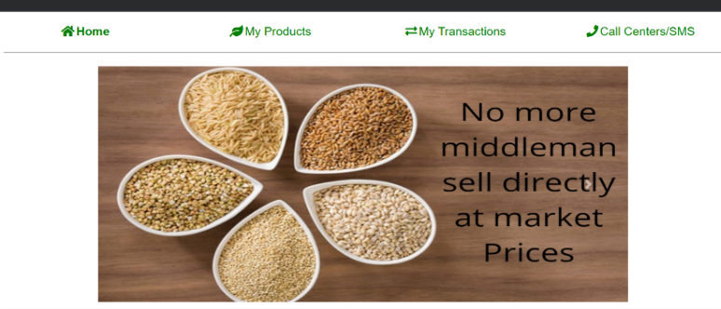
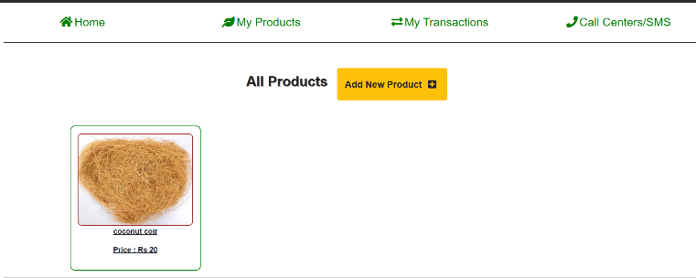
Results
Home page
Login Page
Farmers Home page
Product added

Slide 10
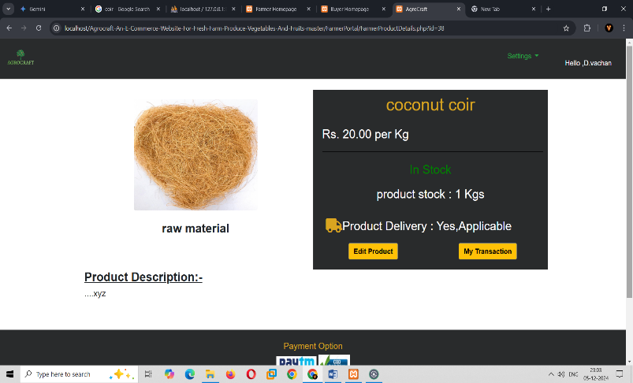
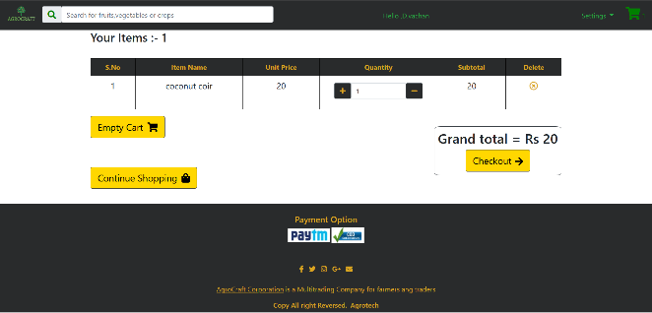
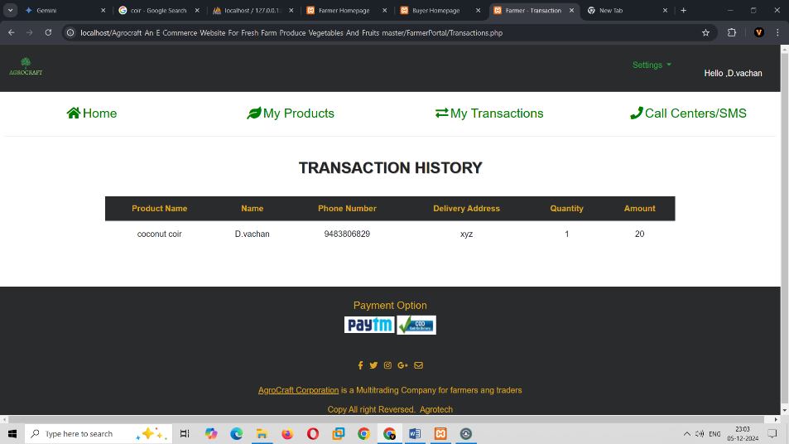
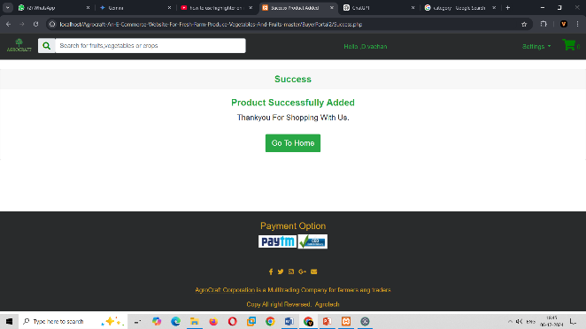
Results
Updation and details of product
Product added to Cart
Transaction column
Payment Interface

Slide 11
Conclusion
Proposed web platform addresses the critical need for real-time transparency and communication between coconut farmers, industries, and data analytical firms. By providing a seamless system for updating raw material availability, completing transactions, and ensuring data-driven insights, the platform enhances efficiency and trust within the supply chain.
This solution ultimately empowers farmers, improves decision-making for industries, and supports better market analysis, driving overall growth in the coconut industry

Slide 12
References
https://www.researchgate.net/publication/239861971_AGRIBAZAAR_A_VIRTUAL_TRADING_PLACE_FOR_FARMERS
https://www.cio.inc/dehaat-uses-ai-apis-to-solve-problems-15m-farmers-a-20914#:~:text=DeHaat%2C%20a%20full%2Dstack%20agri,institutions%20across%2012%20Indian%20states.
https://www.cs.princeton.edu/~rdondero/iw/15Agarwalla.pdf
https://www.researchgate.net/publication/340921110_CropIn_Addressing_Farmer_Poverty_Through_Connected_Farming
https://www.forbesindia.com/article/agritech-special-2022/bighaat-a-crop-advisory-for-farmers/79567/1

Slide 13
Thank You

